Slide 1
Database
Connect with the Driver
Microsoft Access (2003/ 2007)
SQL Server, MySQL and Oracle Database
Presented by: Ma Myint Myint

Slide 2
Java Database Connectivity (JDBC)
Java
Connection
ODBC
JDBC
SQL
Database
connection
Programming layer
//Name given eg: ans1

Slide 3
Connect With the Database
Create database in the MS Access (or) SQL
Save in the myDocument or any Location

Slide 4
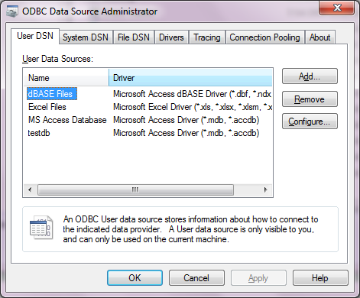
Connection
Start/
Control Panel/
Administrative Tools/
DataSource(ODBC)/
ODBC DataSource Administrator dialog box will be appeared.
In the User DSN(DataSource Name), choose the related driver
Add button is add new connection
Remove button is delete the connection
Configure button is modify the connection

Slide 5
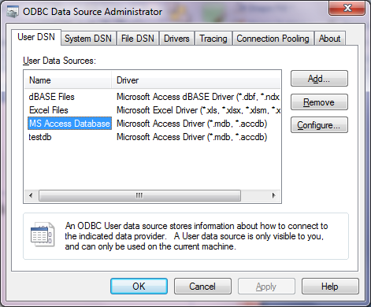
Connection
If you want to connect with the Microsoft Access database 2003, 2007
Choose the MS Access Database
Then click Add button

Slide 6
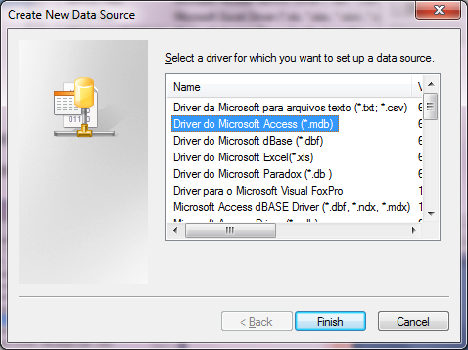
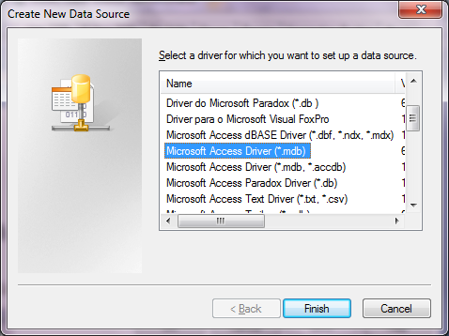
Connection
If you want to connect with MS Access 2003
Choose the Microsoft Access Driver(*.mdb) or
Choose Driver to Microsoft Access (*.mdb)

Slide 7
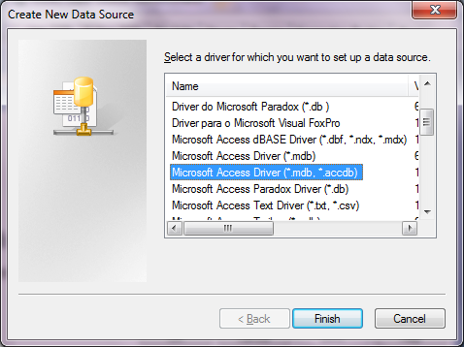
Connection
If you want to connect with MS Access 2007
Choose the Microsoft Access Driver(*.mdb,*.accdb)

Slide 8
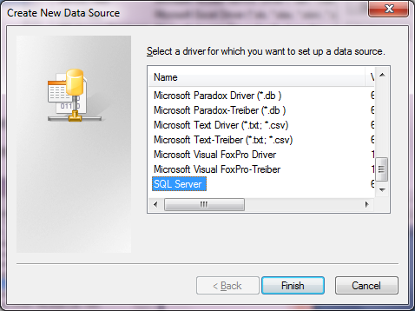
Connection
If you want to connect with SQL Server 2000/2005 or MySQL
Choose the SQL Server

Slide 9
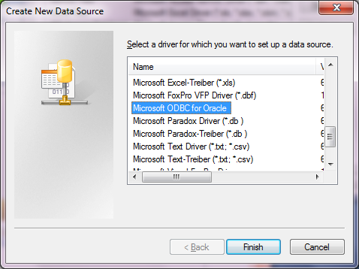
Connection
If you want to connect with the Oracle Database
Choose Microsoft ODBC for Oracle

Slide 10
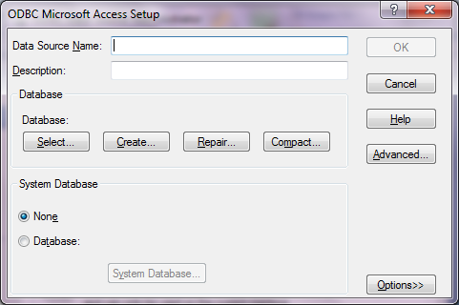
Connection
After choosing the driver,
Click Finish
After that,ODBC Microsoft Access Setpu dialog box appeared.

Slide 11
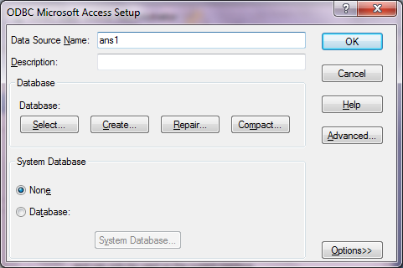
Connection
Then fill the Data Source Name : eg ans1
Then click the Select button

Slide 12
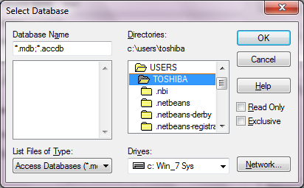
Connection
Then choose the location of the database,
Eg: your database is in the my Document,
Choose C:\Users\TOSHIBA\Documents (double click)

Slide 13
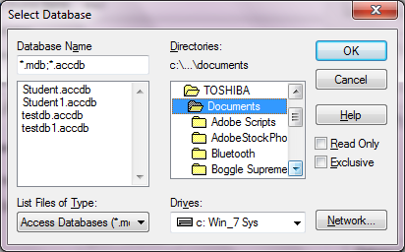
Connection
After double clicking, you can view all of the database in the my Document.

Slide 14
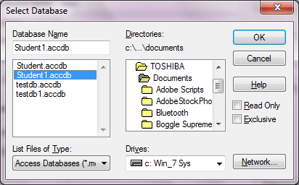
Connection
Then choose the database you want to connect
Then click OK (triple)

Slide 15
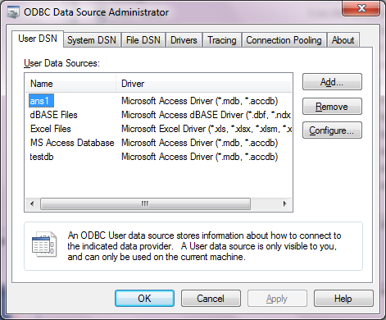
After connection
You can view the connection in the ODBC Data Source administrator

Slide 16
Thank you!!!

